Slide 1
rPod Description
Dennis Kaloi
October 27, 2014
Notes:
This template can be used as a starter file for presenting training materials in a group setting.
Sections
Sections can help to organize your slides or facilitate collaboration between multiple authors. On the Home tab under Slides, click Section, and then click Add Section.
Notes
Use the Notes pane for delivery notes or to provide additional details for the audience. You can see these notes in Presenter View during your presentation.
Keep in mind the font size (important for accessibility, visibility, videotaping, and online production)
Coordinated colors
Pay particular attention to the graphs, charts, and text boxes.
Consider that attendees will print in black and white or grayscale. Run a test print to make sure your colors work when printed in pure black and white and grayscale.
Graphics, tables, and graphs
Keep it simple: If possible, use consistent, non-distracting styles and colors.
Label all graphs and tables.

Slide 2
Software Overview
1
2
Command Line Interface
3
Scripting
Operating System
4
Clips
Notes:
Give a brief overview of the presentation. Describe the major focus of the presentation and why it is important.
Introduce each of the major topics.
To provide a road map for the audience, you can repeat this Overview slide throughout the presentation, highlighting the particular topic you will discuss next.

Slide 3

Operating System
Disc Operating System (FAT 32)
Two Processor, Multi-tasking, Unified I/O
I/O Pre-Processing
1 KHz major cycle for scripting
16 Scripts running simultaneously
Built in debugger
OS is Field Upgradable
Notes:
This is another option for an overview using transitions to advance through several slides.

Slide 4
Command Line Interface
Console, DTE, DMX, Midi, and Ethernet
All script commands can be entered thru CLI
System configuration
Script execution and debugging
Interface to other controllers
Data logging
Auxiliary Device Interface and Control

Slide 5

Scripting - Programs
Full Automation and Advanced Control
Three Execution Modes
  Manual
  Boot
  Program
16 Simultaneous Sequences of 2048 Lines each
Local, Global, and Public variables
Program Flow
  Delay
  Branch
    Goto
    If..else
    Select case
  Do while Loops
  for loops
Debug
  Go
  Halt
  Step
  Break
  List

Slide 6

Scripting – Event Lists
Fixed Show Control based on a Timer Reference
  Linear Show Playback
  Only one Event list may be active at a time
  Up to 64 Event Lists per processor
  Switchable on the fly
  Global in nature and can be placed in any one of the 16 sequences
Events
  A time cue with an associated command, operation, or function
  A cue point uses a bracketed timer constant : [hh:mm:ss.ff]
  It can be placed in the program body or in an Event List
Control
  Eventlist = “Name”
  TIMER on / off / hold / Offsets
  TIMER Assignment “TIMER = 20”

Slide 7
Clip Based Metaphors
  Provides a friendlier programming environment
  Clips simplify playback setup and reduce the complexity of a sequence or event list.
  Track assignments can be made automatically
  Helps to minimize errors.
Notes:
This is another option for an overview slide.

Slide 8
Channels vs Tracks
Channels are physical outputs on the Unit.
A Track is a pseudo container for referencing a single sound and its playback characteristics.
Other Track playback characteristics
  Duck and UnDuck Sound Volume
  Attack and Decay times
  Pause, Resume, Append, Position, and Skip
  Status
A Track can use either a mono or stereo sound file.
Playback can be on either a single Channel or a Channel Pair depending on the command.
Multiple Tracks can be played back on a single Channel
Tracks assignment can be manual or automatic
Notes:
What will the audience be able to do after this training is complete? Briefly describe each objective and how the audience will benefit from this presentation.

Slide 9
How to Play an Audio File
Play Command (Ready, Set, Go)
  Opens a sound file
  Sound data is loaded to the Track buffer
  Playback of audio is started
Ldsnd Command (Ready, Set)
  Opens a sound file
  Sound data is loaded to the Track buffer
  Waits for a Start command to begin Playback
Start Command (Go)
  Playback of the specified audio track is started
Play vs Load
  Use Play when Timing or Synchronization is not Critical
  Use Ldsnd and Start to reduce latency or synchronize play back of multiple audio tracks
Append Command (Relay Race)
  Cues a sound on a Track to be played when an existing sound is completed
  Seamless and sample accurate
  Cue depth is one
Loop Command
Unloop Command
Makeloop Command
Stop Command
Pause Command
Resume Command
Position and Skip
Notes:
Add slides to each topic section as necessary, including slides with tables, graphs, and images.
See next section for sample table, graph, image, and video layouts.

Slide 10
How to Adjust Volumes
Channel Volume (Cvol)
  Hardware Control, Range 0 – 127, 0 = OFF, 127 = Full Volume
  No software Attack or Decay setting
  Channel lists supported
  Hardware Volume Ramp. ~15 ms to go from 127 to 0
  Avoid large changes to Cvol while playing
Track Volume
  Software Control, Range 0 – 127, 0 = OFF, 127 = Full Volume
  Track Lists supported
  Affected by Attack, Decay, and Duck commands
  Attack and Decay protects large changes to Tvol while playing
Duck and Unduck Volume
  Software Control
  Track Lists supported
Mute and UnMute
Notes:
Keep it brief. Make your text as brief as possible to maintain a larger font size.

Slide 11
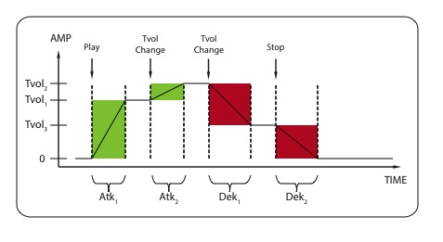
Crossfades and Transitions
Attack/Decay Time
  Range 0 – 127, 0 = None, 127 = 12.7 seconds
  Log Taper
  Track lists supported

Slide 12
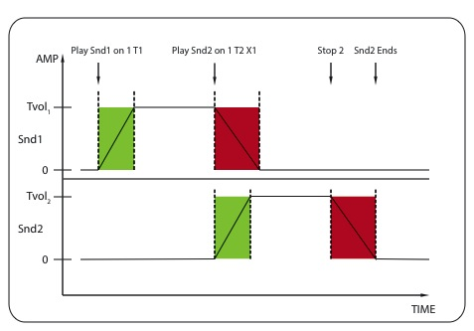
Crossfades and Transitions
Uses Play(m) or Ldsnd(m)/Start
Crossfade w/ Command modifier “X”
Supports Track Lists
Notes:
If there is relevant video content, such as a case study video, demo of a product, or other training materials, include it in the presentation as well.

Slide 13
Sequence Purpose
Full automation and Advanced Control
Input Stimulus
  Input Triggers
  Serial Ports
  DMX Recording
  Ethernet
  Midi
  Real Time Clock
  System Timer
  Microphone and Line Inputs
Output Response
  Sound Playback
  Output Control
  Serial Ports
  DMX Lighting Control
  Ethernet
  Midi
  Data Logging
Notes:
Add a case study or class simulation to encourage discussion and apply lessons.

Slide 14
Sequence Format
Standard Text Files with a .seq extension
Auto Boot Sequence named “startup.seq”
Two Pass Compiler performed on a Ldseq or Playseq Command
Stored on the Compact Flash Card
Layout
  Description Example
  Variable definitions and Group enumerations Define x
  Variable initialization x = 0
  Port initialization Config Console = 9600
  Control File Mounting Mount light1 on 1
  Subprogram loading Ldseq Show1 on 2
  Main loop start main Playseq 1
  Program body x = x + 1
  Main loop end Goto main
  Event Lists Eventlist Show1
  [10:35] Play Sqam on 1 Endlist
Key Points
  All input stimulus should be polled in the program body section.
  The main loop section can be alternately written with the “do-while” or “for” loops.
  The sequence will terminate if it runs out of instructions to execute.
Notes:
Discuss outcomes of the case study or class simulation.
Cover best practices.

Slide 15
Using Input Triggers
Trigger types
  Trigger Input: Trig1-Trig12
    Returns the instantaneous state of the trigger
    0 = off, not asserted.
    1 = on, asserted
  Trigger Assertion: Close1 - Close12
    Sticky, returns closure detection state
    0 = falling edge of trigger was not detected
    1 = falling edge of trigger was detected
    Reading Close reset the state to zero
  Trigger Release: Open1 - Open12
    Sticky, returns release detection state
    0 = rising edge of trigger was not detected
    1 = rising edge of trigger was detected
    Reading Open reset the state to zero
  Trigger Word: Inputs
    Returns the instantaneous state of all triggers
    Binary coded where trigger 1 has a weighting of 1 and trigger 8 = 128
    0 = no triggers are on and 4095 = all 12 triggers are on (255 for 8 trigger Mini-Sam)
Example program segment
    J1 if Close1 == 1
    Play Flim on 1 T1
    endif
    Goto J1
Notes:
Summarize presentation content by restating the important points from the lessons.
What do you want the audience to remember when they leave your presentation?

Slide 16
Serial Port Triggers
Serial Ports
  Console
  DTE
Read and Peek Command
  Initiates a string capture
  Number of characters can be specified
  Can be locked to prevent loss of data
  Release returns serial port to the default command input state
  #/& Numeric/ASCII Conversion feature
Read Status
  ?Console and ?DTE sticky flags
  Console and DTE are active buffer strings
  Status cleared after read
Example program segment
M0 Read DTE
if ?DTE == 1
if DTE == “Play”
Play Flim on 1
endif
endif
Goto M0

Slide 17
New Clip Database Overview
Tale of Two Sequences
  Old Sequence Program (28 Lines)
Eventlist BCOS ;Contains all playback events
[00:00:00.00] Tvol 1,2,3 = 100 ;Set track 1 volume
[00:00:00.00] Play Sect1 on 1,3,5 T 1,2,3 ;Play Sect1.wav, all outputs, Tracks 1,2,3 (HF, MF, LF) TRIGGER 1
[00:00:00.10] Dek 1,2,3 = 1 ;set Section 1 decay time (tenths of seconds)
[00:00:26.00] Tvol 4,5,6 = 78 ;set S1LOOP volume
[00:00:26.06] Loop S1Loop on 1,3,5 T 4,5,6 ;Start looping S1Loop.wav, all outputs, Tracks 4,5,6 - launch idle loop
[00:00:27.00] Dek 4,5,6 = 1 ;Set Loop decay time (tenths of seconds)
[00:01:30.00] Stop 4,5,6 ;Kill the loop if the train sits idle for more than 60 seconds
[01:00:00.00] Tvol 1,2,3 = 127 ;Set Sect_2 Volume
[01:00:00.00] Play SECT_2 on 1,3,5 T 1,2,3 X 4,5,6 ;Play Section 2 TRIGGER 2, Kill S1Loop Immediately
[01:00:00.05] Dek 1,2,3 = 103 ;Decay time of 10.3 seconds (really, fade down duration)
[01:00:00.05] Tvol 1,2,3 = 115 ;Fade track to this level
[01:00:12.00] Dek 1,2,3 = 5 ;set Section 2 decay
[01:00:39.00] Tvol 4,5,6 = 115 ;Set Sect_3 Volume
[01:00:39.25] Play SECT_3 on 1,3,5 T 4,5,6 X 1,2,3 ;Play Section 3,Kill Section 2
[02:00:00.00] Tvol 7,8,9 = 115 ;Set scream volume
[02:00:00.00] Play Scream on 1,3,5 T 7,8,9 ;Play Scream
[02:00:06.00] Stop 7,8,9 ;Kill Scream
[03:00:00.00] Tvol 1,2,3 = 115 ;Set Section 4 volume
[03:00:00.00] Dek 4,5,6 = 5 ;set Sect_3 decay
[03:00:00.05] Play SECT4 on 1,3,5 T 1,2,3 X 4,5,6 ;Play Section 4, Kill Section 3
[03:00:48.24] Tvol 4,5,6 = 70 ;Set S4LOOP Volume
[03:00:48.24] Loop S4LOOP on 1,3,5 T 4,5,6 ;Loop S4Loop - station return idle
[03:00:49.00] Dek 4,5,6 = 15 ;set S4Loop decay
[03:01:48.00] Stop 4,5,6 ;Kill S4Loop
[03:01:50.00] TIMER off ;Turn off the timer
[03:01:50.00] Printc "Timecode auto disabled.”
Endlist

Slide 18
New Clip Database Overview
  Clip Based Sequence Program (15 Lines)
Eventlist BCOS ;Contains all playback events
[00:00:00.00] Clip Sect1 ; Play Sect1.wav, all outputs, Tracks 1,2,3 (HF, MF, LF) TRIGGER 1, volumeset, decay time
[00:00:26.06] Clip S1Loop ;Start looping S1Loop.wav, all outputs, Tracks 4,5,6 - launch idle loop,set S1LOOP volume
[00:01:30.00] Stop 4,5,6 ;Kill the loop if the train sits idle for more than 60 seconds
[01:00:00.00] Clip SECT_2 ;Play Section 2 TRIGGER 2, Kill S1Loop,Set Sect_2 Volume, Decay time of 10.3 seconds (really, fade down duration)
[01:00:12.00] Dek 1,2,3 = 5 ;set Section 2 decay
[01:00:39.25] Clip SECT_3 ;Play Section 3,Kill Section 2,Set Sect_3 Volume
[02:00:00.00] Clip Scream ;Play Scream, Set scream volume
[02:00:06.00] Stop 7,8,9 ;Kill Scream
[03:00:00.05] Clip SECT4 ;Play Section 4, Kill Section 3, Set Section 4 volume, set Sect_3 decay
[03:00:48.24] Clip S4LOOP ;Loop S4Loop - station return idle, Set S4LOOP Volume, set S4Loop decay
[03:01:48.00] Stop 4,5,6 ;Kill S4Loop
[03:01:50.00] TIMER off ;Turn off the timer
[03:01:50.00] Printc "Timecode auto disabled.”
Endlist

Slide 19
New Clip Database Overview
One New Command: Clip “file name”
Two Items required to Play a Clip
  Sound File (.wav)
  Clip File (.clip)
Two Ways to Manage a Database
  Clip Manager Application “Clipmet”
  Standard ©Microsoft Access database (.accdb)
The Data Base
  Two Relational Record Sets
    Parent Clip List
    Child Track List

Slide 20
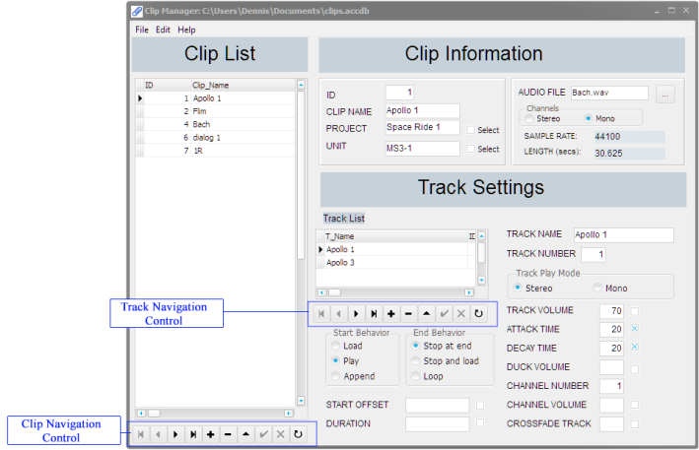
New Clip Database Overview
Clip Manager Main window

Slide 21
Creating and Playing a Clip
(Demonstration)
Creating a New Entry
Exporting a Clip from the Database
Playing the Clip

Slide 22
Questions?

